Slide 1
FRC 4662
Robot Computer Systems Overview

Slide 2
Competition
Field
Control
System
Cat5
WiFi
Driver
Station
Robot
Home
Game
WiFi

Slide 3
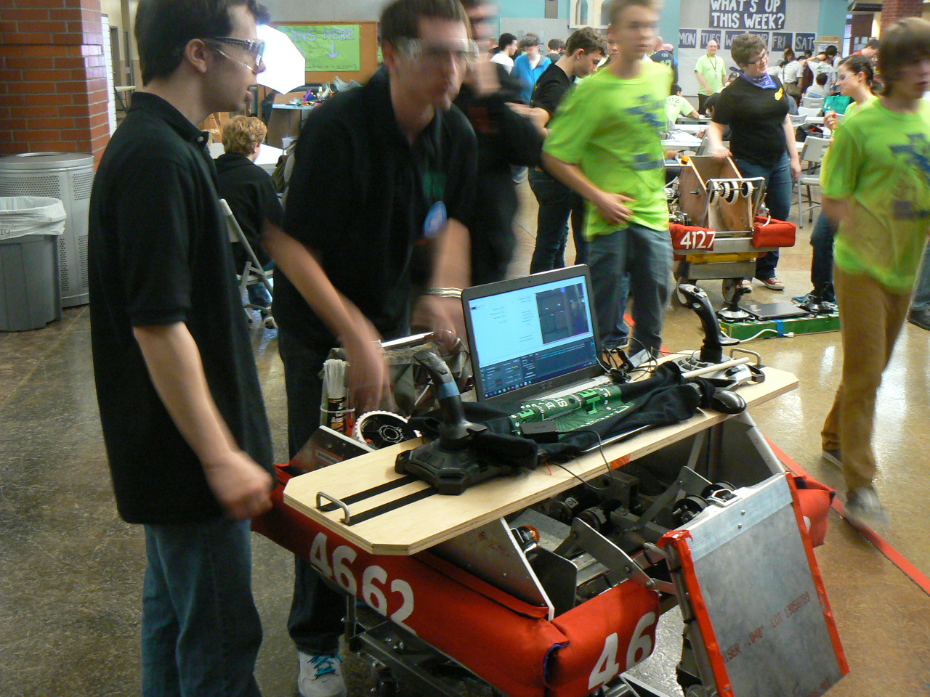

Slide 4
Driver Station
Windows laptop
At home – basic WiFi to the router mounted on the robot
At competition – cabled in to field control system (WiFi is OFF) so they have control
Joystick(s), Keyboard, Gamepad, buttons, other HID as needed
FRC Driver’s Station software installed
Two pieces
Driver station
SmartDashboard – customizable display
Auxiliary Tools
Filezilla (ftp files to/from RoboRIO)
Radio Configuration Utility
Developer Workstation
Latest edition of the code for last minute changes/fixes between rounds
A programmer should be part of drive team
document issues
makes fixes BETWEEN rounds
https://wpilib.screenstepslive.com/s/4485/m/24192/l/144976-frc-driver-station-powered-by-ni-labview
https://wpilib.screenstepslive.com/s/4485/m/26401

Slide 5
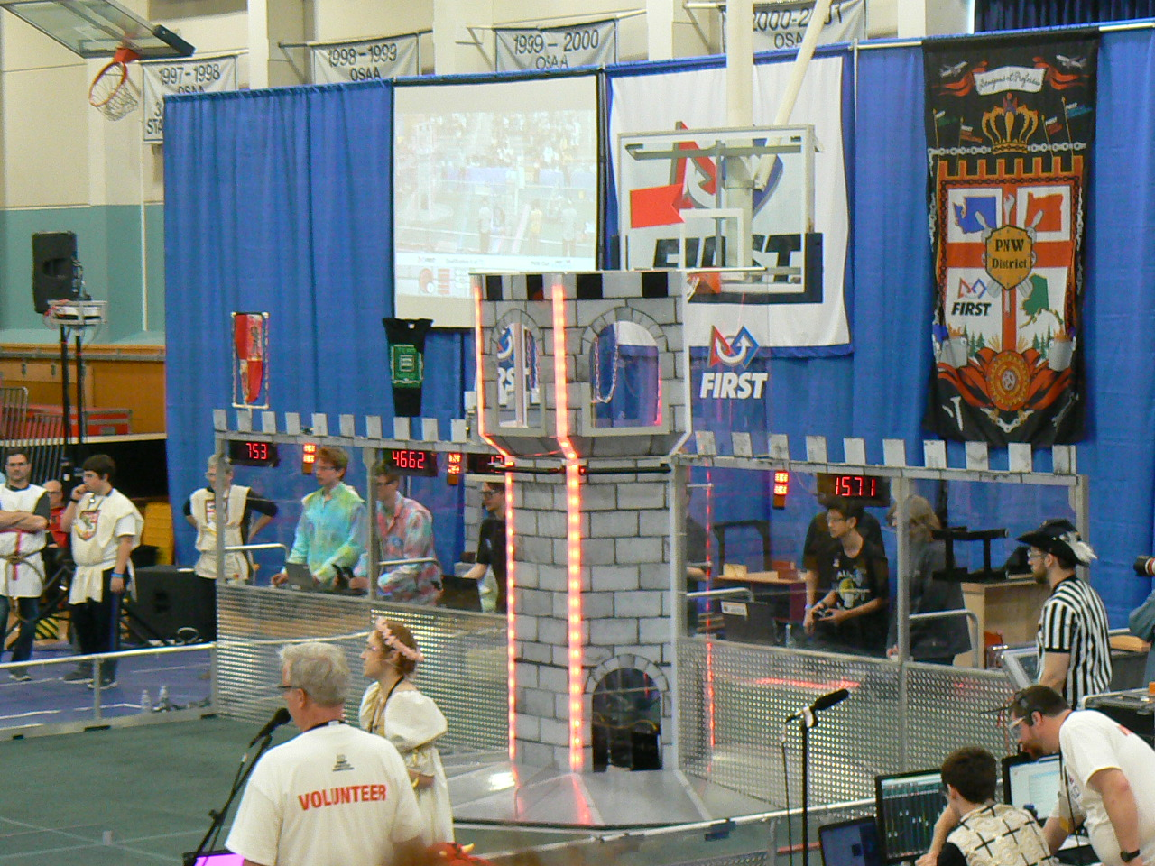

Slide 6
Field Control System
Hardwired network for drivers stations
three per alliance
two alliances
Master controls
Set “states” to control the match
Disabled
Autonomous
Tele-Op
Emergency Stop
Game Over
It could be more robust…
Black Box – get used to it
WiFi overloads
Limited to 7MBS for each robot which can get crowded with cameras left at HD
Problems reported last year with new features that worked at “home” but not at competition
this is a VOLUNTEER heavy organization

Slide 7
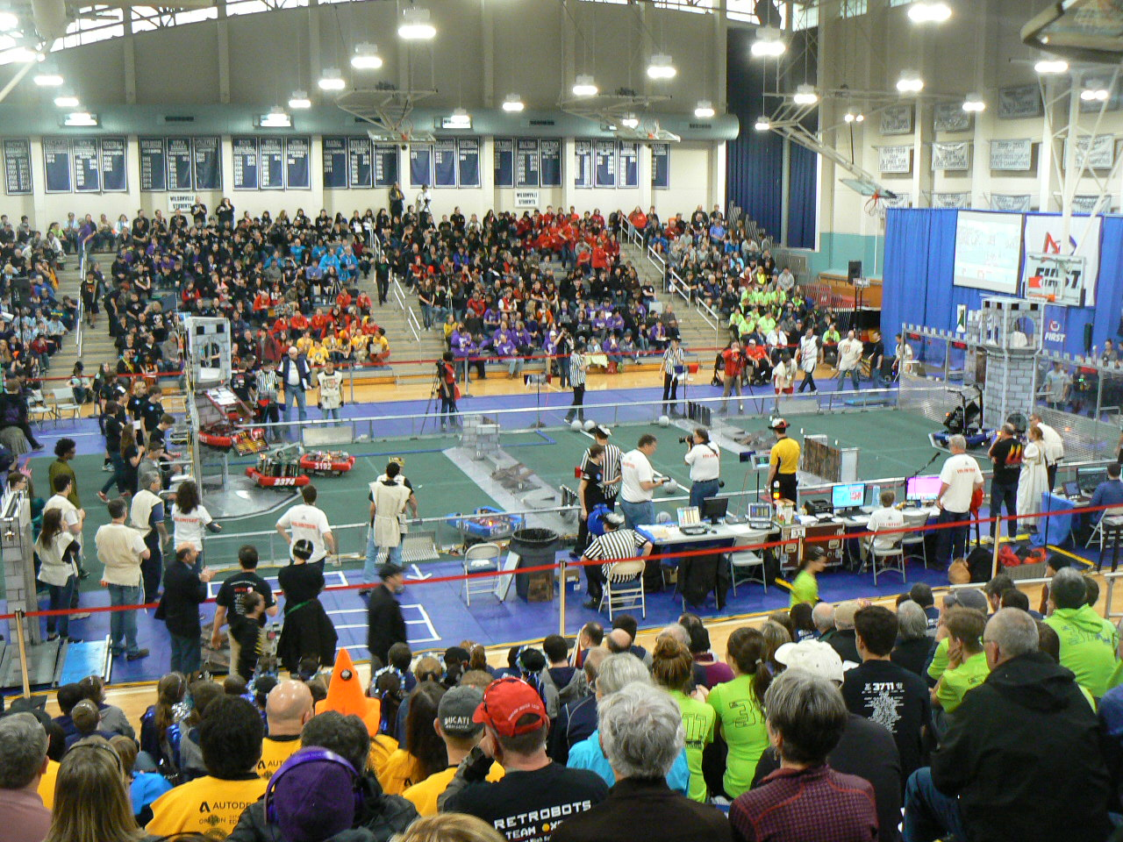

Slide 8
Robot
RoboRIO
proprietary for FRC
required to be IN CONTROL of all motor controllers and moving parts
physical ports for PWM, CAN, I2C, SPI, USB, RS232, Digital I/O, Analog I/O, and Relays as well as an expansion port
Actuators
Speed (Motor) Controllers of several different makes and models (PWM and CAN)
(note to build team – each make/model has it’s OWN CODE – differences mean code changes)
Relays
Pneumatics Control Module (PCM – uses CAN bus)
Sensors
What makes a robot a ROBOT – autonomous control
Gyro (old is analog, new models appear to use I2C or expansion port)
Encoders (digital I/O)
Potentiometer (analog)
Limit Switches (digital I/O)
Ultrasonic (analog)
https://wpilib.screenstepslive.com/s/4485/m/24166/l/144968-2016-frc-control-system-hardware-overview

Slide 9
RobRIO FRC “Shell”
Robot
OI and RobotMap
Configuration
Subsystems
Drive
Commands
Joystick Drive

Slide 10
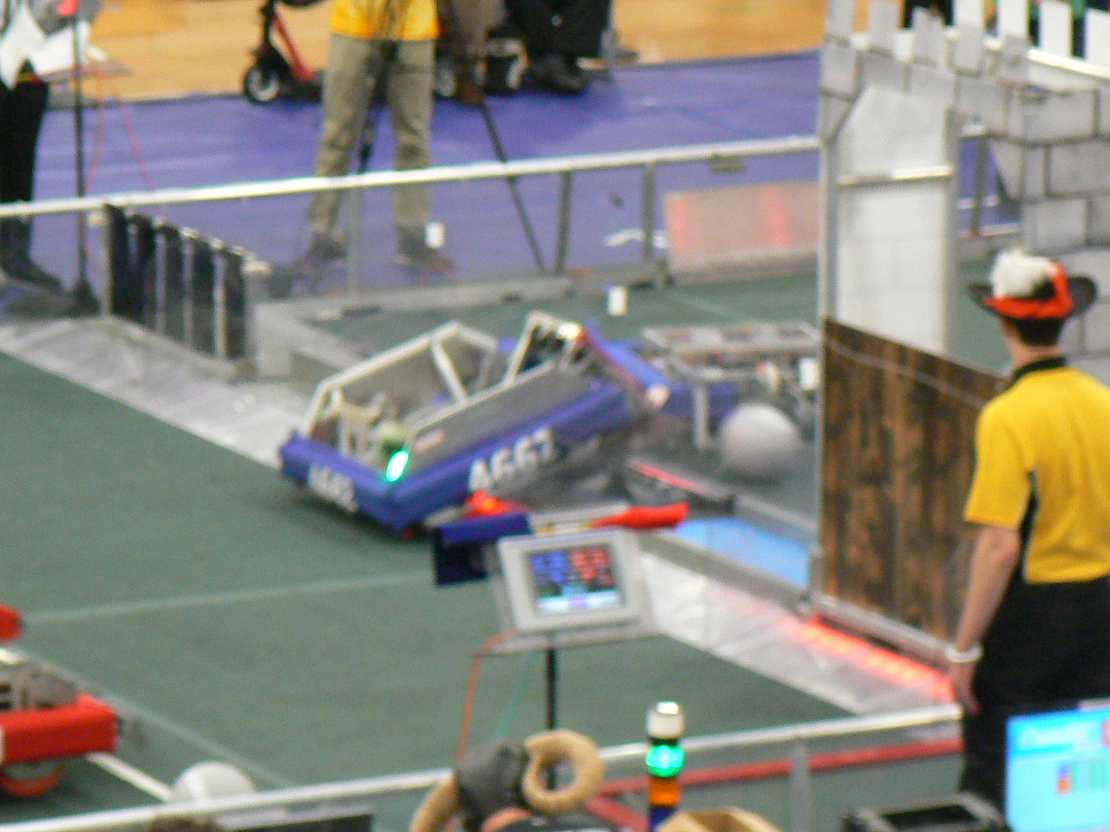

Slide 11
FRC “Shell”
Robot
OI and RobotMap
Configuration
Subsystems
Drive
Commands
Joystick Drive
ERROR HANDLING

Slide 12
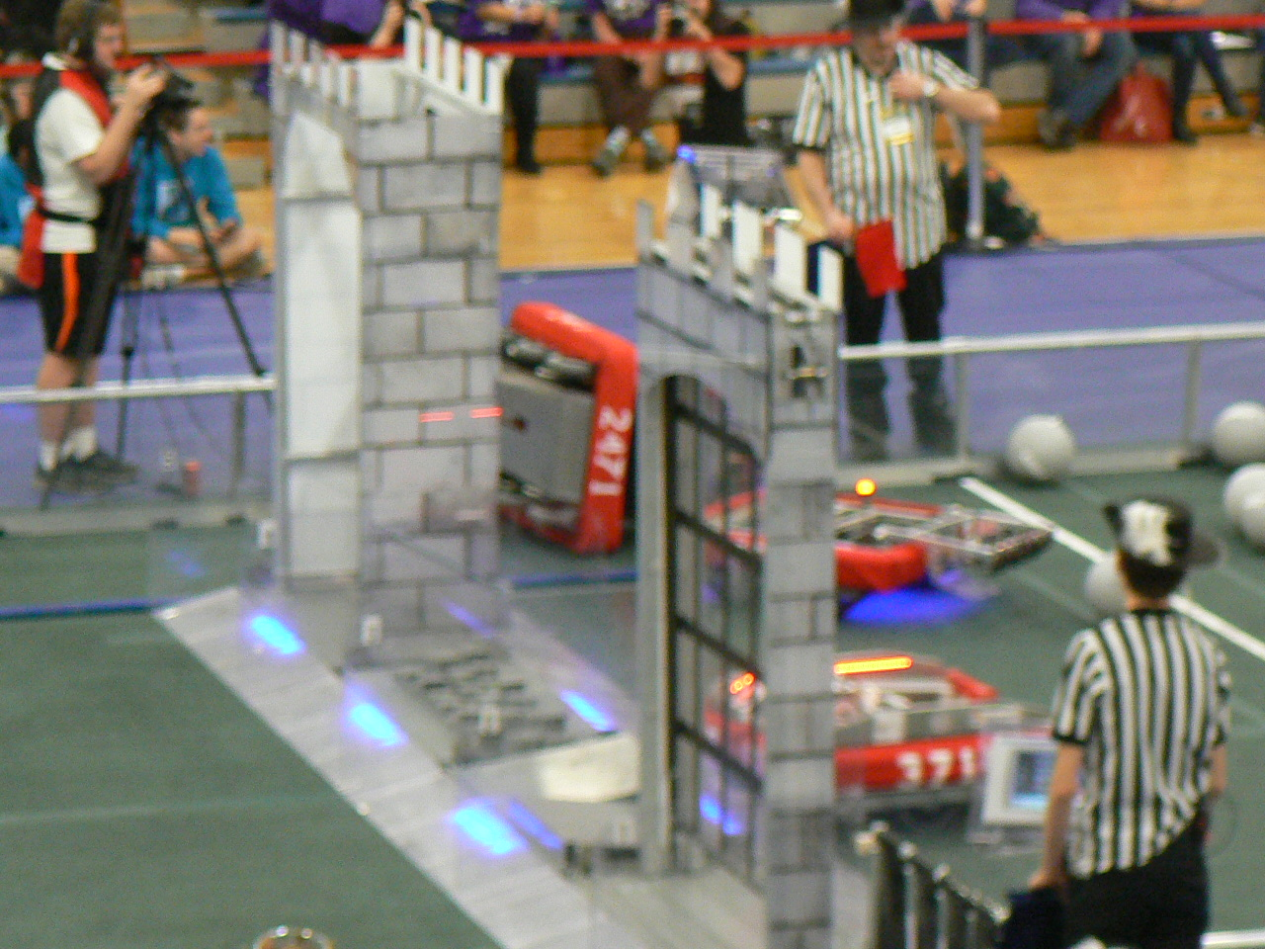

Slide 13
